Slide 1
Tourism Trends Sharon Orrell February 2016

Slide 2
The Market Context

Slide 3
From inflation to deflation
A halt in inflation has helped boost household budgets

Slide 4
Meanwhile wages have grown faster than inflation for first time since 2007
Source: Oxford Economics 2015

Slide 5
Exchange rate continues to make European holidays more affordable for UK residents – and the UK less affordable for Eurozone residents
Source: Oanda

Slide 6
Feelings about the downturn – the profile of a recession
Source: VisitEngland Staycation Research

Slide 7
Businesses are becoming more confident as well
Source: VisitEngland Tourism Business Monitor

Slide 8
The Headlines

Slide 9
2015 has seen differing domestic overnight trends by trip purpose
Trips
(m)
YTD
Holiday
+5%
VFR
+10%
Business
0%
Source: GBTS

Slide 10
How are Brits changing their holiday taking?
Trips
(m)
Numbers of Domestic Holidays Taken by GB Residents
(est based on YTD)
Source: GBTS

Slide 11
How are Brits changing their holiday taking?
Trips
(m)
Numbers of Domestic / Overseas Holidays Taken by GB Residents
(est based on YTD)
Source: GBTS / International Passenger Survey

Slide 12
What happened last time around?
Recession
Source: UKTS / IPS

Slide 13
In total, 1.3 billion tourism day visits are taken in England each year Volumes were down slightly in 2015 (-3% year to November) – but people spent more (+3%) and there was growth in some key sectors of the market
+7%
+2%
Source: GBDVS

Slide 14
Inbound visits to the UK reached a record level in 2014, and 2015 looks set to beat this
Jan – Nov 2015
Visits +4%
Expenditure 0%
Source: International Passenger Survey

Slide 15
Farm Attractions – A Success Story (1) 2013-14 Growth
All attractions
average (+4%)
2012/13 change
(%)
Country parks
Farms
Gardens
Historic houses / castles
Other historic properties
Leisure / theme parks
Museums / art galleries
Steam / heritage railways
Visitor / heritage centres
Wildlife attractions / zoos
Workplaces
Places of worship
Other
+2
+8
+2
+7
+10
+1
+4
+1
+6
+6
+4
+13
+3
Source: Annual Survey of Visits to Visitor Attractions

Slide 16
Farm Attractions – A Success Story (2) Indexed Growth since 1989
Source: Annual Survey of Visits to Visitor Attractions

Slide 17
2013/14 Change in Marketing Expenditure Money well spent?
% down
(All attractions 11%)
% up
(All attractions 18%)
Country parks
Farms
Gardens
Historic houses / castles
Other historic properties
Leisure / theme parks
Museums / art galleries
Steam / heritage railways
Visitor / heritage centres
Wildlife attractions / zoos
Workplaces
Places of worship
Other
Source: Annual Survey of Visits to Visitor Attractions

Slide 18
Understanding Trends The Changing Domestic Consumer

Slide 19
The changing domestic holiday in England – 2006 - 2015
-2.6
Source: GBTS

Slide 20
NB: “discretionary thrift” is a habit that’s likely to stay with us
“This is habit forming, rather than just a blip. For younger people, a significant proportion of their life has been spent in this climate - it’s seen as weird to pay over the odds”
Gavin Flynn, Senior VP, IHG
Source: Trajectory / VE Trends Research

Slide 21
…and the recession hasn’t just brought about a change in the amount people spent
Earn
Discern
Flair
Care
Thoughtless
Spendthrifts
‘In the know’
Wealth
Health

Slide 22
The changing domestic holiday in England – 2006 - 2015
-2.6
Source: GBTS

Slide 23
The population is becoming older
UK population change 2013-2020
Under 18s
+10%
More younger people
18-34s
+1.2%
35-49s
-3.4%
Fewer ‘squeezed middle’
50-64s
+10.5%
More older people (NB – baby boomers are now retiring – a different mindset than previous generations!)
65-79s
+11.2%
80+
+19.2%

Slide 24
...though the current baby boom will also have an impact
UK population change 2013-2020
Under 18s
+10%
More younger people
18-34s
+1.2%
35-49s
-3.4%
Fewer ‘squeezed middle’
50-64s
+10.5%
More older people (NB – baby boomers are now retiring – a different mindset than previous generations!)
65-79s
+11.2%
80+
+19.2%

Slide 25
...piling pressure on the squeezed middle
UK population change 2013-2020
Under 18s
+10%
More younger people
18-34s
+1.2%
35-49s
-3.4%
Fewer ‘squeezed middle’
50-64s
+10.5%
More older people (NB – baby boomers are now retiring – a different mindset than previous generations!)
65-79s
+11.2%
80+
+19.2%

Slide 26
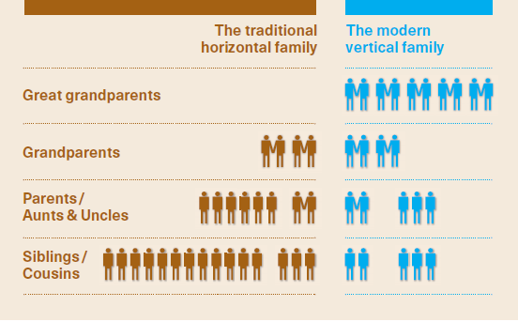
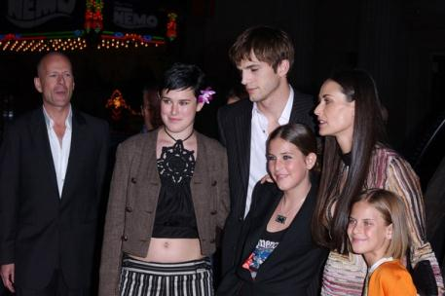
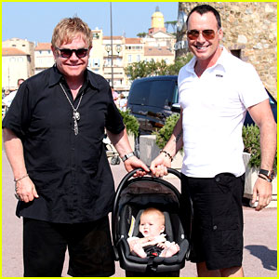
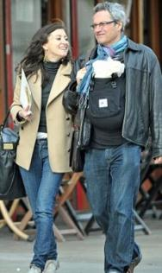
And remember…families aren’t what they were

Slide 27
The changing domestic holiday in England – 2006 - 2015
-2.6
Source: GBTS

Slide 28
Holiday trips are generally getting shorter
“It doesn’t feel right spending too much on holiday just now”
It means we can make most of a long weekend …and means we can have more short holidays rather than longer ones
Source: GBTS

Slide 29
Last minute bookings make it hard for businesses to plan ahead – but offer opportunities to capture spontaneous trip takers
Source: GBTS: All holidays with firm booking

Slide 30
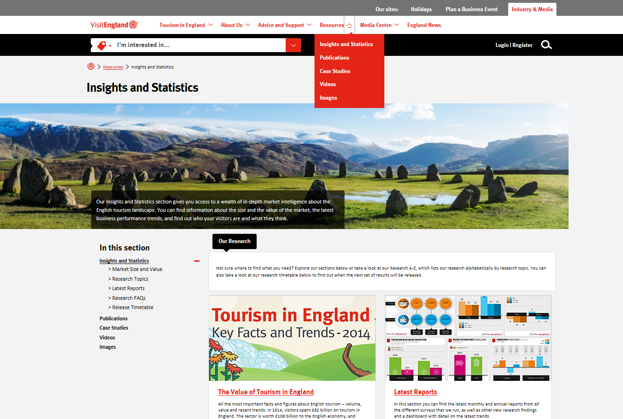
www.visitengland.com/biz

Slide 31
Tourism Trends Sharon Orrell February 2016

