Slide 1
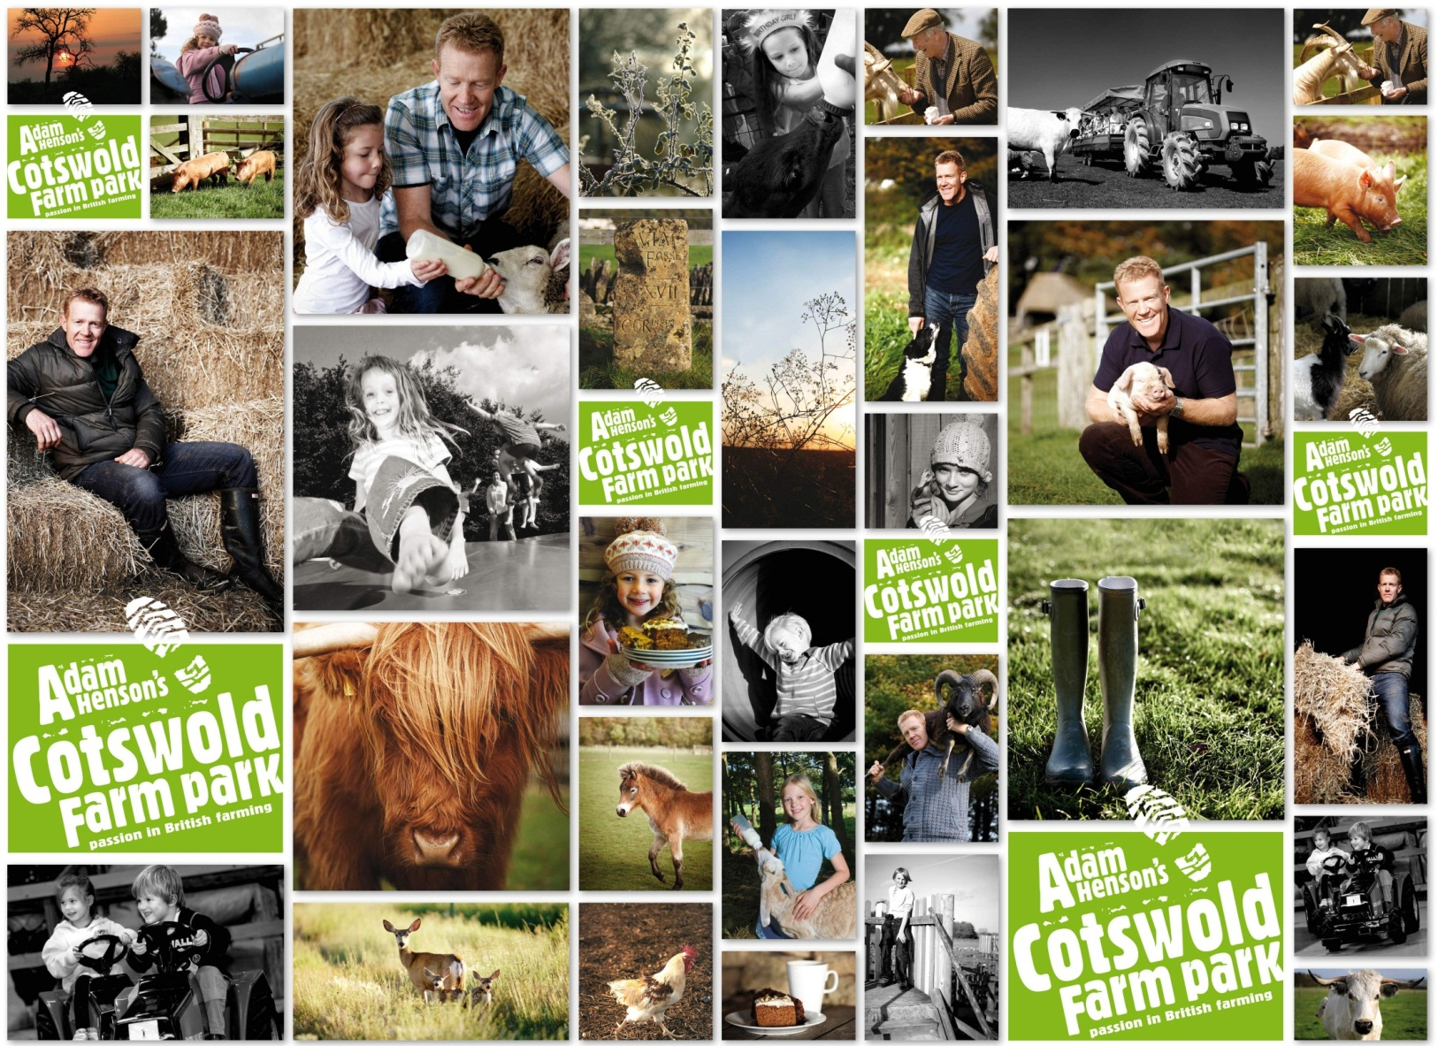
Farm Attraction of the Year 2014

Slide 2
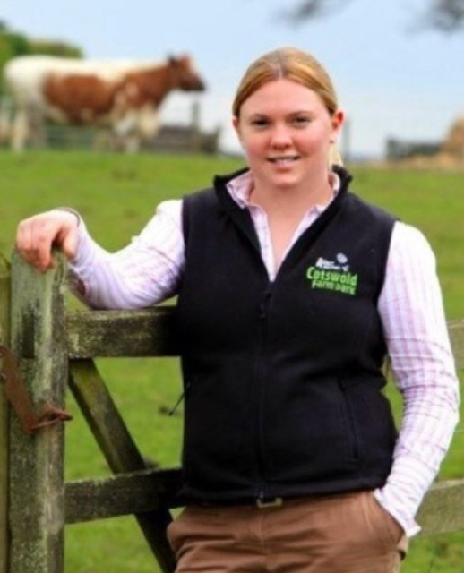
Kate Lord – Farm Park Manager
Adam Henson’s Cotswold Farm Park
Joined Cotswold Farm Park in 2011
Graduated from Harper Adams University in 2007 with BSc in Rural Enterprise and Land Management
Previously worked in Estate Management for the Buccleuch Group from 2007-2011
Qualified as a Rural Surveyor in 2009
Just completed Worshipful Company of Farmers/Duchy College Challenge of Rural Leadership Course

Slide 3
Dancefloor or Balcony?
Adam Henson’s Cotswold Farm Park

Slide 4
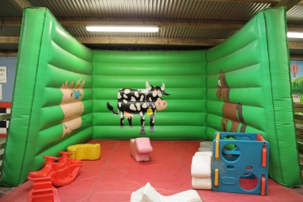
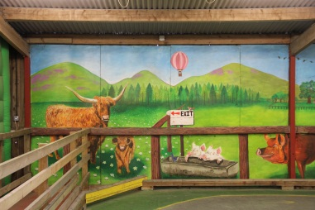
Challenge Assumptions
Notes:
What assumptions have you made on site? Challenge these

Slide 5
What does ‘good’ look like?

Slide 6
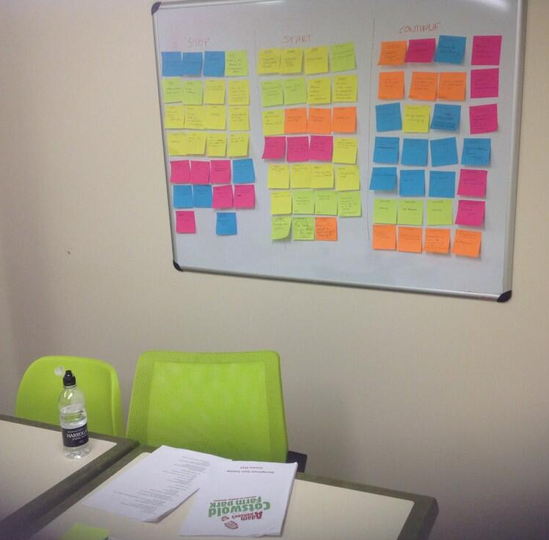
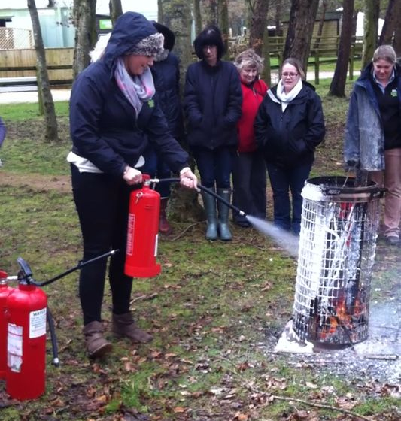
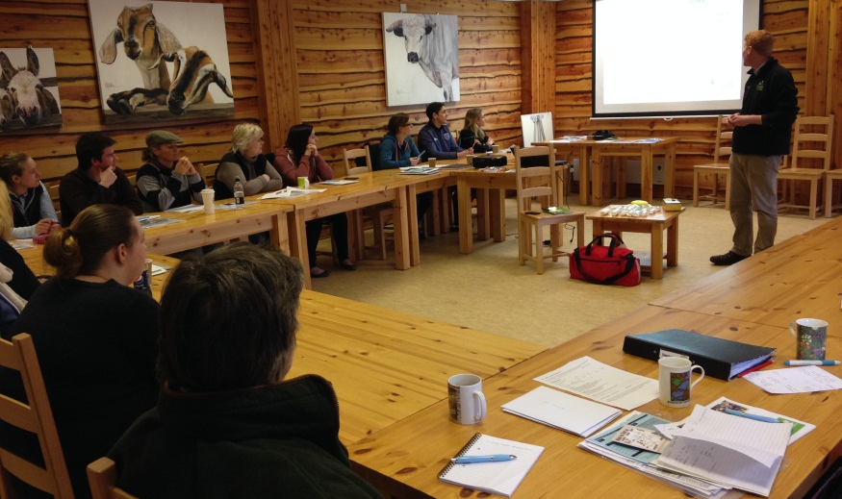
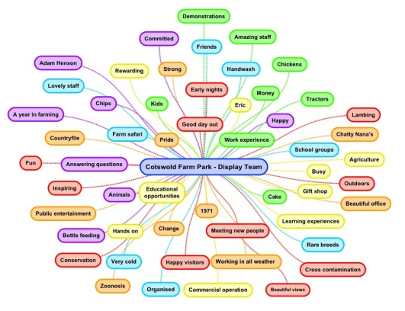
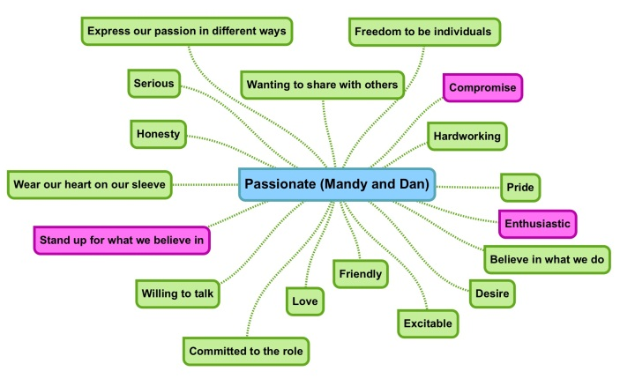
Make time for your team

Slide 7
The Dream Team

Slide 8
Five takeaway questions…
What ASSUMPTIONS do you make about your site or your visitors?
- List some and brainstorm alternatives
- Think outside the box
What does GOOD look like?
- What standards are you trying to achieve?
- What do your team think ‘good’ looks like
Do you INVEST in your staff and risk they leave, or don’t and risk they stay?
- What basic training do all staff need on your site?
- What added value does this bring your customers?
4. What does your dancefloor look like from the balcony?
- How much time do you spend in combat mode/firefighting?
- What systems or staff can be developed?
- Do you reflect as much as you plan?
5. Do you have a COMPELLING vision?
- Have you asked your staff why they like working for you?
- Does this align with your corporate vision, mission, value statement etc?

Slide 9
Communicate & Collaborate
Staff from other Farm Parks are welcome to visit us at any time
Contact: kate.lord@cotswoldfarmpark.co.uk
@CotswoldKate
@AdamHenson
@CotswoldFarmPrk
Myself or a Duty Manager will be happy to show you around

